Slide 1
AMES HOUSING
DEVELOPMENT
DSI 33
Mary-Anne | Wei Zhe | Daniel | Jimmy | Yan Da
Notes:
Presentation order :
Mary-Anne - intro, background, problem statement, work flow process, cleaning data
Wei Zhe - features selection - visualization
Daniel - model
Jimmy - Recommendation, limitation
Yan Da - moving forward, conclusion

Slide 2
CONTENTS
Background
Problem Statement
Workflow Process
Conclusion & Recommendations

Slide 3
BACKGROUND
Real Sky Estate Development has been developing residential areas around Ames and is looking to procure and develop new housing in the area.
Previous housing developments were not returning favourable profits due to the recent pandemic and political tensions. It also caused a rise in the costs of living and building materials over the years.
Facing a forecasted recession in the upcoming year, Real Sky senior management team has reached out to our data science team to pinpoint factors that will direct towards revamping the company’s focus structure to improve the attractiveness and sales price of new housing developments.

Slide 4
PROBLEM STATEMENT
What core features should we, Real Sky, focus on to increase the sale price of homes for our next development project?

Slide 5
WORKFLOW PROCESS
DATA
CLEANING
EDA &
VISUALISATION
FEATURE
SELECTION
MODEL &
EVALUATION

Slide 6
AMES HOUSING DATASET OVERALL
DATA
80 Features
2930 Entries
Home sales from Years 2006-2010
3 TYPES OF DATA
Numerical
Square foot | No. of
Ordinal
Excellent, poor, average
Nominal
Material types | Names
MISSING VALUES
Replaced with best fit values
Median Values
Removed
Misc Features : 97% Missing Values

Slide 7
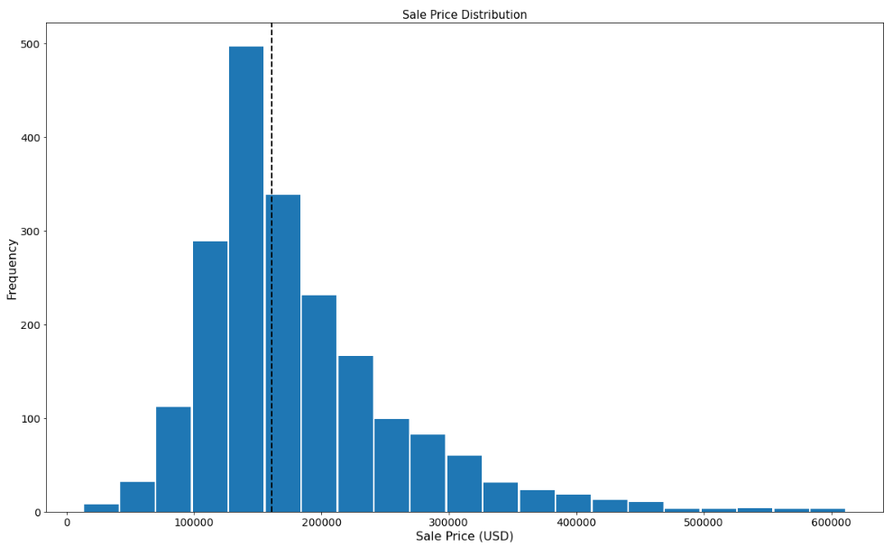
EDA: DISTRIBUTION OF HOUSING SALE PRICE WITHIN 100K TO 300K USD
~160,000 USD
Main distribution of sale prices within 100-300K USD range.
Median sale price at ~160,000
Limited data for sale prices
< 50K and > 400K.
Notes:
Thank you mary-ann.
In our exploratory data analysis (EDA), we plotted the distribution of housing sale prices.
What we observed from the histogram plot, was that the main distribution of sale prices falls within the 100 to 300K USD range, with the median sale price at ~160K.
We can further see from the plot, that there were limited data for sale prices greater than 400K and lower than 50K.
This is an expected observation, as the demand for houses with higher sale prices are expected to be lower, due to their affordability. And for houses lower than 50K sale prices, they probably have features which are undesired, causing those cases to fall into the low price ranges.

Slide 8
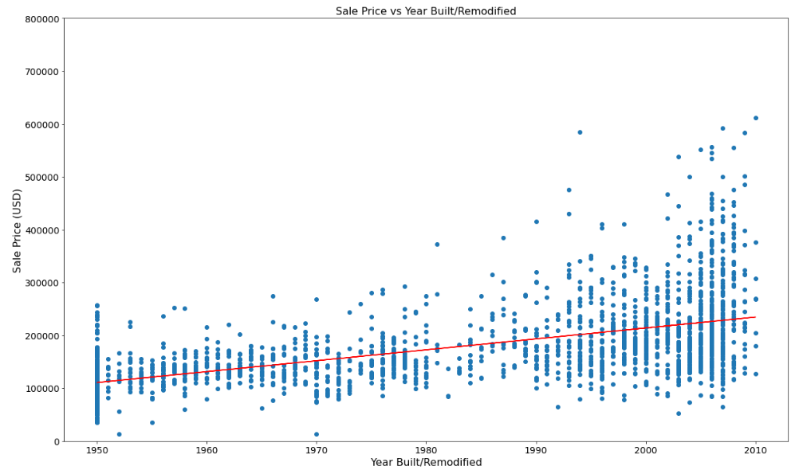
EDA: MINIMAL IMPACT OF YEAR BUILT/REMODIFIED ON SALE PRICES
Correlation Coefficient = ~0.5
Model creation for sale price prediction of new housing developments.
Weak correlation coefficient value of ~0.5.
Poor linearity between Sale Pricing and Year Built/Remodified.
Not a significant factor that will affect sales price.
Notes:
As mentioned by mary-ann, our team is coming up with a model to predict sale price values of new housing developments, and we are working with a data set that contains data of houses that were built from 1950 till 2010, we need to first ensure that the age of the house is not a significant factor that affects historical sale prices.
Looking at the correlation coefficient of the scatter plot of sale price vs year built/remodified, we see a weak correlation coefficient value of 0.5.
What this means is that there is poor linearity between sale pricing and year in which the house was built.
Thus we can conclude that the age of the house in our dataset, is not a significant factor that affects housing sales prices.

Slide 9
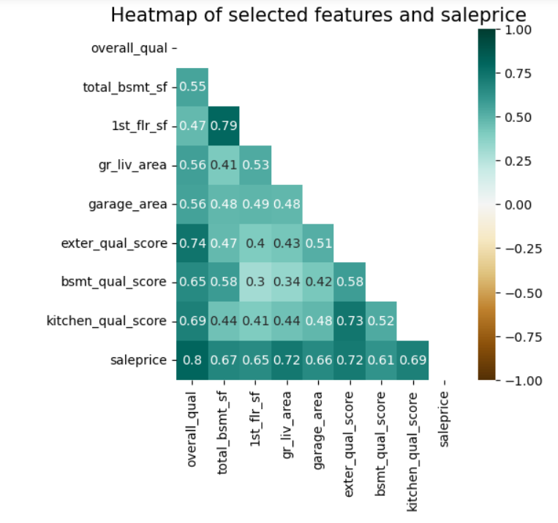
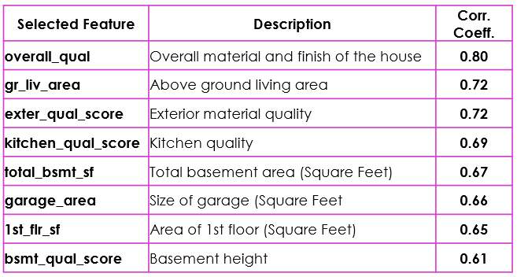
FEATURES SELECTION : FEATURES WITH > 0.6 CORRELATION COEFFICIENT WITH SALE PRICE
Notes:
After conducting our EDA, we move on to feature selection for model training.
Here we applied the pearson correlation to come up with a correlation matrix to determine the pairwise correlation of the features in the dataset to sale price.
The figure in the slide shows a zoomed in matrix to the features we have selected, and these features have minimally >0.6 correlation coefficient with sale price.
From the correlation matrix, we selected 8 numerical and ordinal features which includes overall quality, above ground living area, , external quality score, kitchen quality score, total basement area, garage area, 1st floor area, and basement quality score.

Slide 10
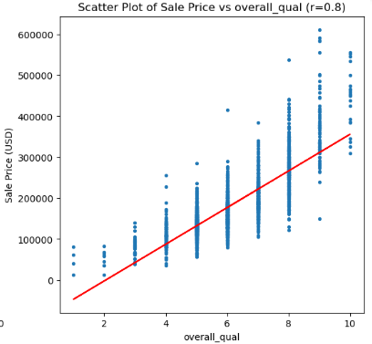
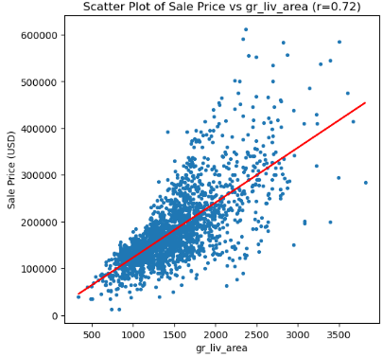
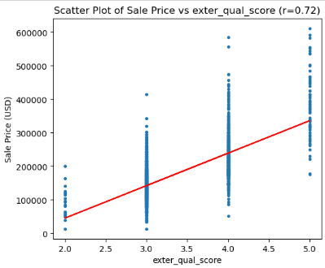
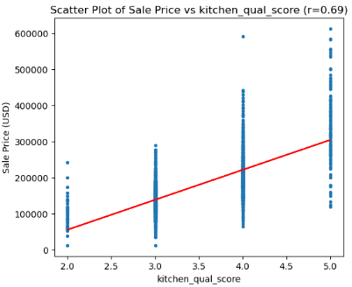
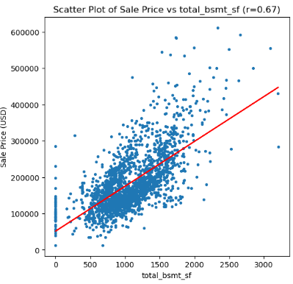
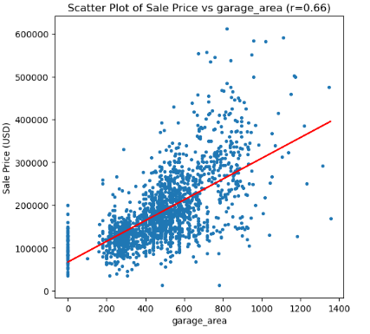
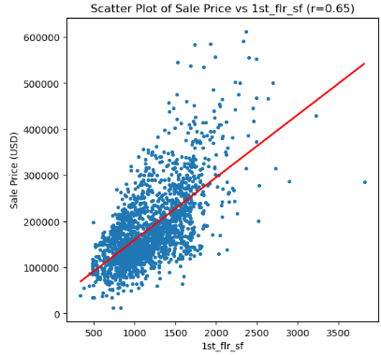
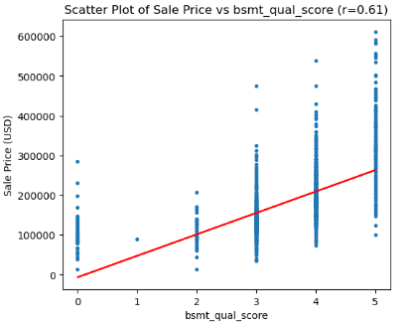
FEATURES SELECTION : POSITIVE CORRELATION BETWEEN SELECTED FEATURES AND SALE PRICE
Notes:
Generally these 8 features all are positively correlated to sale prices. However having a strong correlation with sale price does not mean causation, and that’s where our model comes into play, to enable us to select the core features with significant impact to sales price.

Slide 11
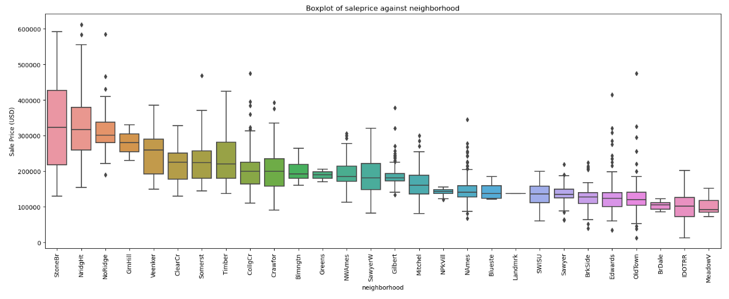
FEATURE SELECTION : SELECTION OF “Neighborhood” AS MODELLING FEATURE
Good location as one of the top 5 most desired home features from Forbes*.
Top 3 locations with better sales price:
Stone Brook
Northridge Heights
North Ridge
Reference links:
https://www.forbes.com/sites/forbesrealestatecouncil/2020/04/27/15-most-desirable-home-features-to-todays-buyers/?sh=7997a5677a4e
Notes:
Other than the 8 numerical and ordinal features that were selected as inputs to our model, we have selected one more feature based on our domain knowledge and research.
An article from Forbes, states that having a good housing location, is one of the top 5 most desirable home features to buyers. To further support that statement with data, we can see from the boxplot chart, that there is a trend across different neighborhood locations. This can be interpreted that buyers are more willing to pay more for better locations such as Stone Brook, Northridge Heights and north ridge.

Slide 12
CORE FEATURES: OVERVIEW OF SELECTED FEATURES
OVERALL
QUALITY
TOTAL
BASEMENT
AREA
1ST FLOOR
AREA
ABOVE GROUND
LIVING
AREA
NEIGHBORHOOD
EXTERIOR
MATERIAL QUALITY
BASEMENT
HEIGHT
KITCHEN
QUALITY
GARAGE
AREA
Numerical/Ordinal Features
Categorical Features
Notes:
So, out of the 80 features in our dataset, these are the 9 features that were selected for our model training and creation.
Next i will hand over to daniel, who will bring you through the steps taken during model selection and identify which are the core features which contributes significantly to sales pricing.

Slide 13
MODEL SELECTION - BEST PREDICTION MODEL: RIDGE REGRESSION
Model | Train R2 score | Train RMSE | Test R2 score | Test RMSE
Baseline | - | - | 0.0 | 79277
Linear Regression | 0.88816 | 26256 | 0.86899 | 29765
Lasso Regression | 0.88816 | 26256 | 0.86898 | 29766
Ridge Regression | 0.88816 | 26256 | 0.86901 | 29763
R2 score: measures how much the variability in sale price can be explained by the selected features in our model
RMSE (Root Mean Square Error) : measures the average difference of the predicted value from actual sale price
Higher R2 score Better Model Performance
Lower RMSE Better Model Performance
Notes:
Thank you Weizhe. After identifying the core features, we split our data to train and test dataset for model training and evaluation. For model evaluation, we used R2 score and RMSE (aka root mean square error). R2 score measures how much the variability in sale price can be explained by the selected features. The higher the R2 score, the better the model performance. RMSE measures the average difference of the predicted value from actual sale price. The lower the RMSE, the better the model performance. For our train dataset, all the regression models gave same R2 score and RMSE. For the test dataset, Ridge Regression gave the highest R2 score, which is much higher than our baseline model whereby it uses the mean of the house’s sale price as prediction. Ridge regression also gave the lowest RMSE. With this, our best prediction model is Ridge Regression and this will lead to better prediction to the property’s sale price. Also, high R2 score of 89% suggests that our core features are representative of the sale price prediction.
(1:30 mins)
** show an example of a predicted value against an actual value (maybe can choose a median)

Slide 14
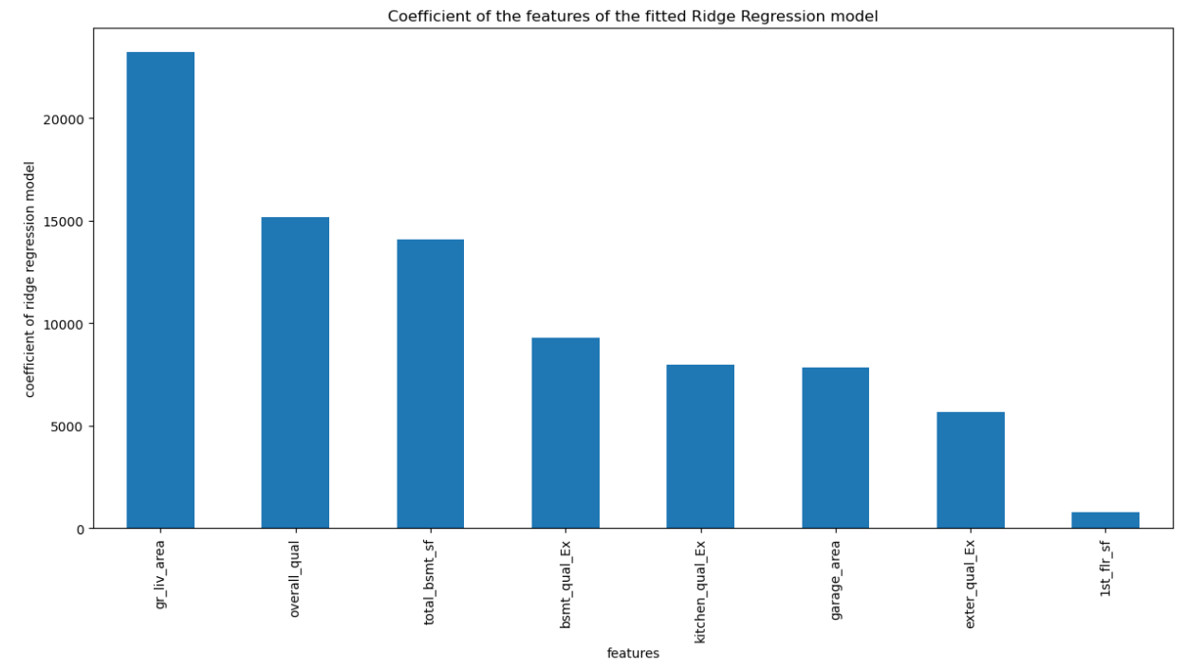
Top 3 features are ground living area, overall quality and total basement area
 | Median
Ground Living Area | 1444 sq. ft.
Overall Quality | Score 6
Total Basement Area | 994 sq. ft.
Notes:
From our prediction model, the top 3 features that have greater impact to the sale price are ground living area, overall quality and basement area. They have higher positive coefficient as compared to the rest. Space and quality of the house are of importance to buyers. Using median as a benchmark, we recommend building houses with dimensions above the median. This will likely have greater impact on the sale price.
~1 min

Slide 15
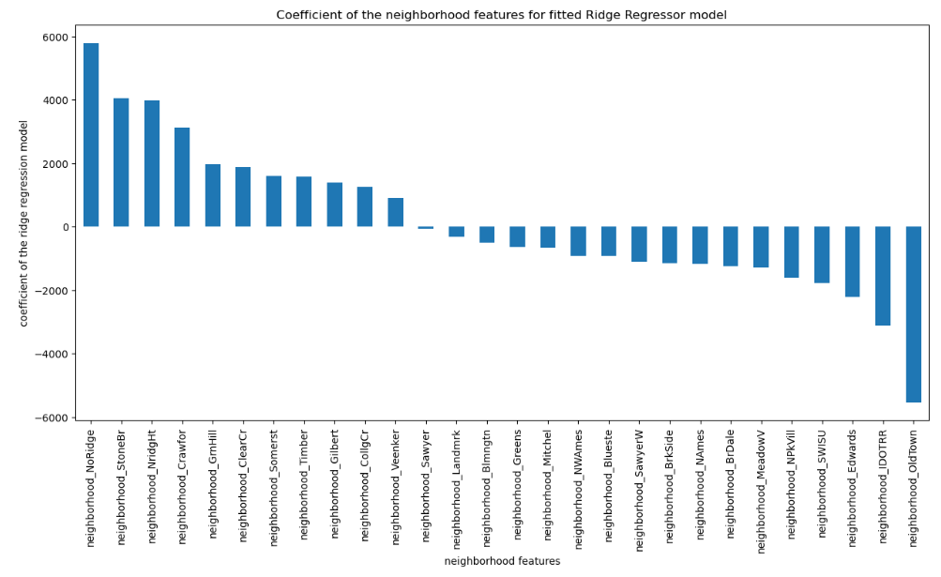
DESIRABLE LOCATIONS
Top 3 neighborhoods:
Northridge, Stone Brook and Northridge Heights
Located North-west of Ames with lower crime rate and better education ranking*
*www.neighborhoodscout.com/ia/ames
Notes:
Next, we identified the 3 top desired neighborhoods by comparing the coefficients obtained from our model. Northridge, Stone Brook and Northridge Heights located at the north-west of Ames have the top 3 positive coefficients with sale price. WIth higher positive coefficient, they are more likely to yield higher sale price. This is supported by our earlier analysis whereby these areas have higher median sale price than the rest. We also conducted further research and found that they have lower crime rate and better education ranking. Areas to avoid are those with negative coefficient, especially Old Town, Iowa DOT and Rail Road and Edwards. I will now handover the presentation to Jimmy.
(30 sec)
Overall ~3:30

Slide 16
LIMITATIONS
INSUFFICIENT DATA
TIME CONSTRAINT
NEW DATA
External factors skewing sale prices (eg. recession, natural disasters)
More recent year data
Different models
Notes:
**Time contraint - hyper parameter tuning
Insufficient data {https://towardsdatascience.com/the-limitations-of-machine-learning-a00e0c3040c6}:
External factors such as natural disasters ,geopolicial, race,nationality,income,inflations may have skewed the sales price. However, the house prices does increase overtime due to land appreciation.[https://www.investopedia.com/articles/mortgages-real-estate/08/housing-appreciation.asp] Results: It might not be a huge factor in the long term horizon of the sales price.
More recent year data to analyze the trends of consumer behaviour and to predict upcoming trend, rising new features
Due to time constraint
- multicollinearity - means 1 independent variable(or features) is highly correlated with one or more of the other independent variable (or features) -> means less accurate results
- limited time to check and remove those features
Our sol :
No control of such data but it is shown the house price do increase over time due to land appreciation [https://www.investopedia.com/articles/mortgages-real-estate/08/housing-appreciation.asp], which is why, it might not be a huge factor in a long term price of the sales price of house.
for missing data that is more than 5% - we did not include the features in our model. And those missing data were replaced with median values as we assumed it is a normally standard distribution. So, the median values of the data will not be affected. [https://www.mastersindatascience.org/learning/how-to-deal-with-missing-data/]
Multicollinearity : [https://link.springer.com/chapter/10.1007/978-0-585-25657-3_37]
def : Multicollinearity exists whenever an independent variable is highly correlated with one or more of the other independent variables in a multiple regression equation.
How does it affect our results? it undermines the statistical significance of an independent variable.
Our sol: Features that are of high correlation and these features was removed so that the model will have more accurate results.

Slide 17
MOVING FORWARD
MONITORING NEW DATA
CLARITY IN FEATURES VALUES
Garage Qual (Ordinal): Garage quality
Ex Excellent
Gd Good
TA Typical/Average
Fa Fair
Po Poor
NA No Garage
Change in trends
Change in consumer preference
Notes:
**show some screenshots/pictures to better explain the pointers
MOVING FORWARD : 3 key points
talking about what can we do to further about the data set , different types of model, prediction of increase sales price
Monitoring new data - future of the datasets-> it might no longer be relevant due to the change in trends,consumer behaviour/preference, differences in material quality
Change to clarity features values - explaining dict? Can use jimmy previous work experience to explain more. Amenities in the neighbourhood
Different models like neutral network and compare predictions, estimate the possible increase of sale price
Pass next slide to Yan Da to talk about recommendations and conclusion.
Total: 3:30 mins

Slide 18
RECOMMENDATIONS
Potential Development
Area
North-West of Ames
Budget Allocation
Prioritization of Core Features
Marketing
Core Features
Notes:
Recommendations to the audience:
Make examples i.e core feature how can be marketed
As always, location is important in ensuring a high saleprice to customers. Real Sky should prio procurement into areas in the north west location of ames, neighborhood.
Channel more funding into the core features, we can optimize how overhead fees can be funnel better into increasing saleprice.
Marketing - when advertising banners, commercials to show more of the features

Slide 19
CONCLUSION
PROBLEM STATEMENT: What core features should we, Real Sky, focus on to increase the sale price of homes for our next development project?
Top 3 Core features
GROUND LIVING AREA , OVERALL QUALITY, TOTAL BASEMENT AREA
Model used : Ridge Regression (89% R2 Score)
Top 3 Neighborhoods
Northridge, Stone Brook and Northridge Heights
Notes:
Speak about :
So, to conclude, what core features should real sky focus on to increase the sale price for the next development project?
By using the historical data provided by AMES, we perform EDA and data visualisation to identify the top features with a high correlation to saleprice. Comparing to our baseline, we have selected the RidgeCV score as it has the highest R2 score out of all 3 models at a 87%. Therefore, Real sky should focus on the top 3 features, ground living area, overall quality and total basement area, and focus on procuring land in the top 3 neighborhoods.
Interpret the data, i.e so how to increase? Increase the living area?
model accuracy in the slide
Using the core features, we had ultilize the RidgeCV model as it had a 87% accuracy to predict saleprice values of new housing developments.
All these relate back to problem statement
2 mins

Slide 20

THANKS
Notes:
Q&A: Answer as a group

Slide 21
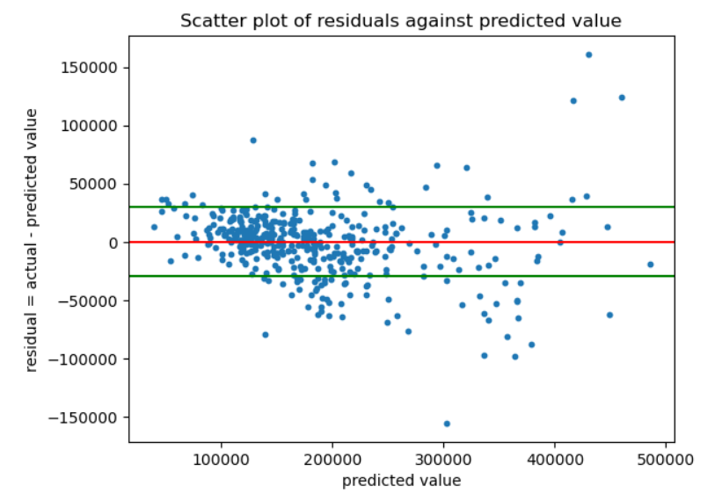
RMSE for Ridge Regression = 29763
y = 29763
y = -29763

Slide 22
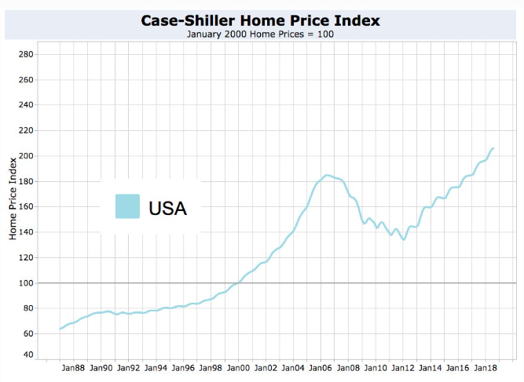
Reference link:
https://www.forbes.com/sites/johnwake/2018/11/02/the-next-housing-bust/?sh=353094318b79
Notes:
The House Price Index (HPI) is a broad measure of the movement of single-family house prices in the United States.
It is published by the Federal Housing Finance Agency (FHFA), using monthly and quarterly data supplied by Fannie Mae and Freddie Mac.

